Slide 1
Monitor
Microsoft Power Platform
Govern
&
Grow
1. Secure
2. Monitor
3. Alert and Action
4. Deploy
5. Nurture
6. Infrastructure
7. Support

Slide 2
Governance – Practically Applied
Secure
Monitor
Manage
Set up Azure AD conditional access Enable cross-tenant isolation Configure data loss prevention policies Define your environment strategy Manage users and their security roles Configure email exfiltration Define your data gateways strategy |  | Track user access Monitor new connectors Report on resource usage Monitor Dataverse usage Set up sharing alerts and mitigations Leverage audit logs from O365 pipeline |  | Automate policies using management connectors Leverage admin PowerShell or admin APIs for automation
Application Lifecycle Management
Managed vs Unmanaged
Learn ALM best practices
Automate ALM using Azure DevOps
Nurture and educate
Establish a Center of Excellence
Educate new makers
Foster best practices
Notes:
It requires focus on multiple aspects including security, monitoring, management, and application lifecycle management for your particular organization. In our Power Platform Governance series, we’ll show you how the Power Platform offers you capabilities in each of these different and important elements for your Power Platform deployment. The tools within the Power Platform help reduce the complexity of governing your environment and empowers admins to unlock the greatest benefits from their Power Platform assets.

Slide 3


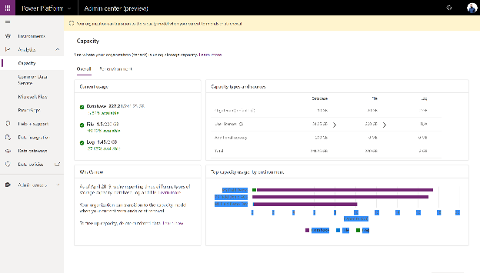
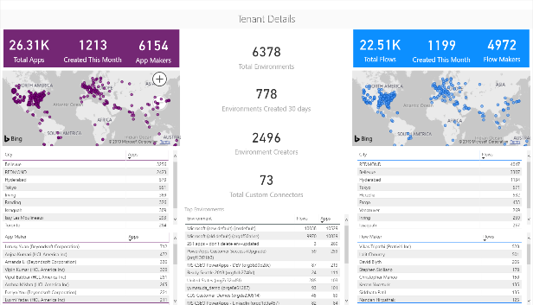

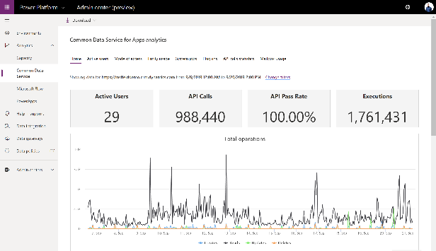
Admin reporting and analytics in the Power Platform admin center
Admin insights provide deep visibility into usage and performance of applications
Users
Locations
Capacity
Personalize insights and drive action with custom Power BI reports and Power Automate
All up view of what’s being created
Discover your champions
Trigger automated actions
Analytics track health and implementation metrics and help keep users on track
Service performance
Error reporting
App usage

Slide 4

Logs & analytics – see what’s happening
Power Apps and Power Automate logs available at https://protection.office.com/
Activity Logging integrated with Office Security and Compliance center for comprehensive logging across Microsoft services.
The audit records are stored in Office 365 Security and Compliance center. Must have an Office 365 E3 or greater license Must enabled at the organization level
Office provides an API to query this data, which is currently used by many SIEM vendors to use the Activity Logging data for reporting
Power Automate | Power Apps
Created flow Edited flow Deleted flow Edited permissions Deleted permissions Started a paid trial Renewed a paid trial | Created app Edited/save app (draft) Published app Deleted app Restored an app from app version Launched app Marking app as featured Marking app as hero Edited app permissions Deleted app permissions
Notes:
Dataverse is focused on database and model-driven app user activity
Power Apps is targeted toward canvas app
The data is stored only in the region that an environment is hosted in.

Slide 5

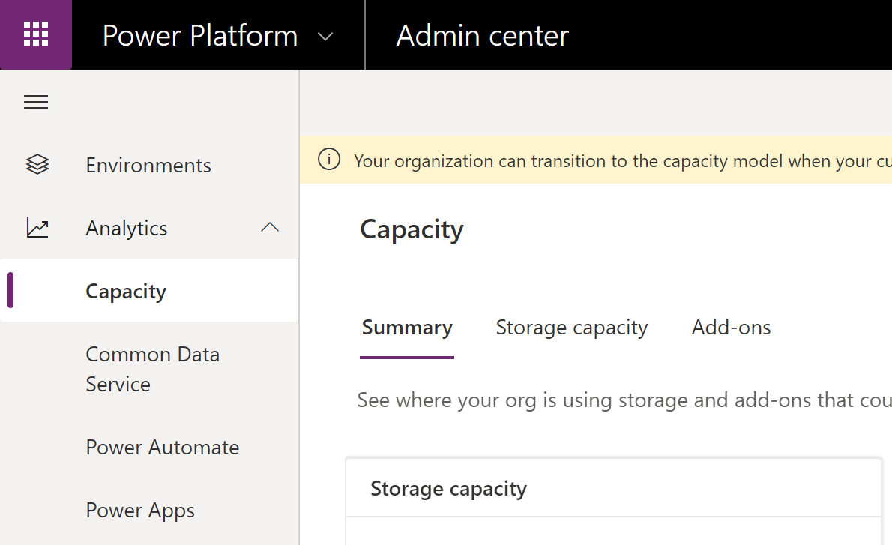
Logs & analytics – see what’s happening
Admin analytics Tenant and environment level analytics Available from Power Platform admin center aka.ms/ppac Access is available for environment admins Data is stored for 28 days Data is refreshed daily
Maker analytics Canvas app and flow level analytics Available from make.powerapps.com and flow.microsoft.com Access is available to app & flow owners (admins can grant themselves access) Data is stored for 30 days Data is refreshed daily
Notes:
Dataverse is focused on database and model-driven app user activity
Power Apps is targeted toward canvas app
The data is stored only in the region that an environment is hosted in.

Slide 6
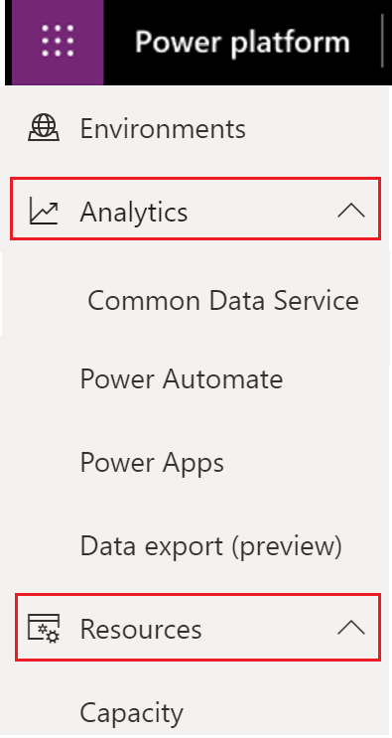
Gain Deeper Insight on Adoption, & Usage
https://aka.ms/ppac
Admin analytics
Environment level analytics
Available from Power Platform admin center
Access for environment admins, power platform service admins, D365 and global admins
Data is stored for 28 days
Data is refreshed daily
Notes:
Dataverse is focused on database and model-driven app user activity
PowerApps is targeted toward canvas app
The data is stored only in the region that an environment is hosted in.

Slide 7
Detailed Insight on Microsoft Dataverse
View insights at the environment level
Number of active users, trends, top active users
Mode of access by OS, device type, browser, business unit, security role
Dataverse out of the box and custom entity usage based of Creates, Reads, Updates, Deletes
System Jobs, Plug-in’s and API call statistics
Number of active users, trends, top active users
Mode of access by OS, device type, browser, business unit, security role
Dataverse out of the box and custom entity usage based of Creates, Reads, Updates, Deletes
System Jobs, Plug-in’s and API call statistics
As an administrator:
Confirm access modes by OS, device types or browser is compliant with standards of your organization
Understand specific CRUD (Create, Read, Update, Delete) activities performed with your apps
Get an overview of overall health by regular checks on platform API calls, system jobs operating, plug-in’s used by app makers
Notes:
Dataverse is focused on database and model-driven app user activity
PowerApps is targeted toward canvas app
The data is stored only in the region that an environment is hosted in.

Slide 8
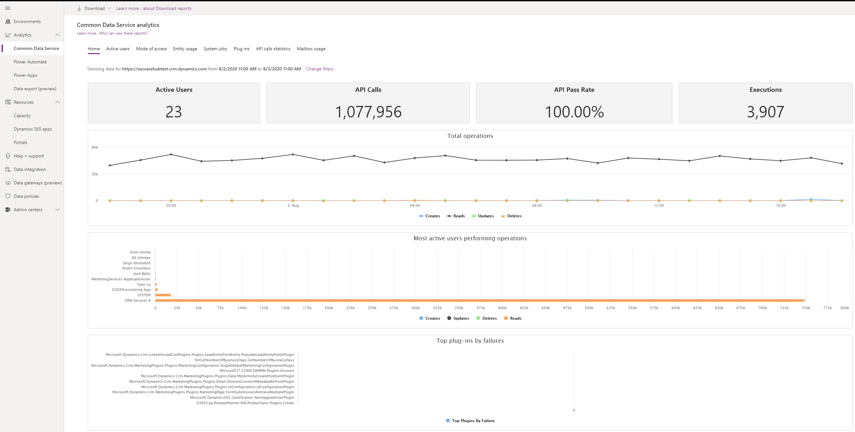
Monitoring Microsoft Dataverse
Click on Change Filters to select from a list of environments you have access to, as well as adjust the date range. The data will only be presented in the prior 28-day period.
Notes:
Microsoft Dataverse is focused on database and model-driven app user activity
PowerApps is targeted toward canvas app
The data is stored only in the region that an environment is hosted in.

Slide 9
Power Automate admin analytics provides environment level views
Administrators can view data at the environment level
Type of flows created
Flow creation trends
Created flow list of view
Run metrics – Active runs, success and failure
Flow in use and trend
Shared flows and types, flow names, number of shares
Connectors by runs, number of connections, flows involved and drill down on flows
Total number of errors based off error types
Errors across flows with list of errors by flow name
As an administrator:
Monitor usage and look for insights related to types of flows that ae in use
Identify common errors by looking for errors by error type
Get insights into connector usage per flow along with flow creator email. Adjust data loss prevention policies to ensure no unnecessary flows are created in the environments and ensure overall security of platform
Note – UI flow analytics is available in the COE toolkit
Notes:
Microsoft Dataverse is focused on database and model-driven app user activity
PowerApps is targeted toward canvas app
The data is stored only in the region that an environment is hosted in.

Slide 10
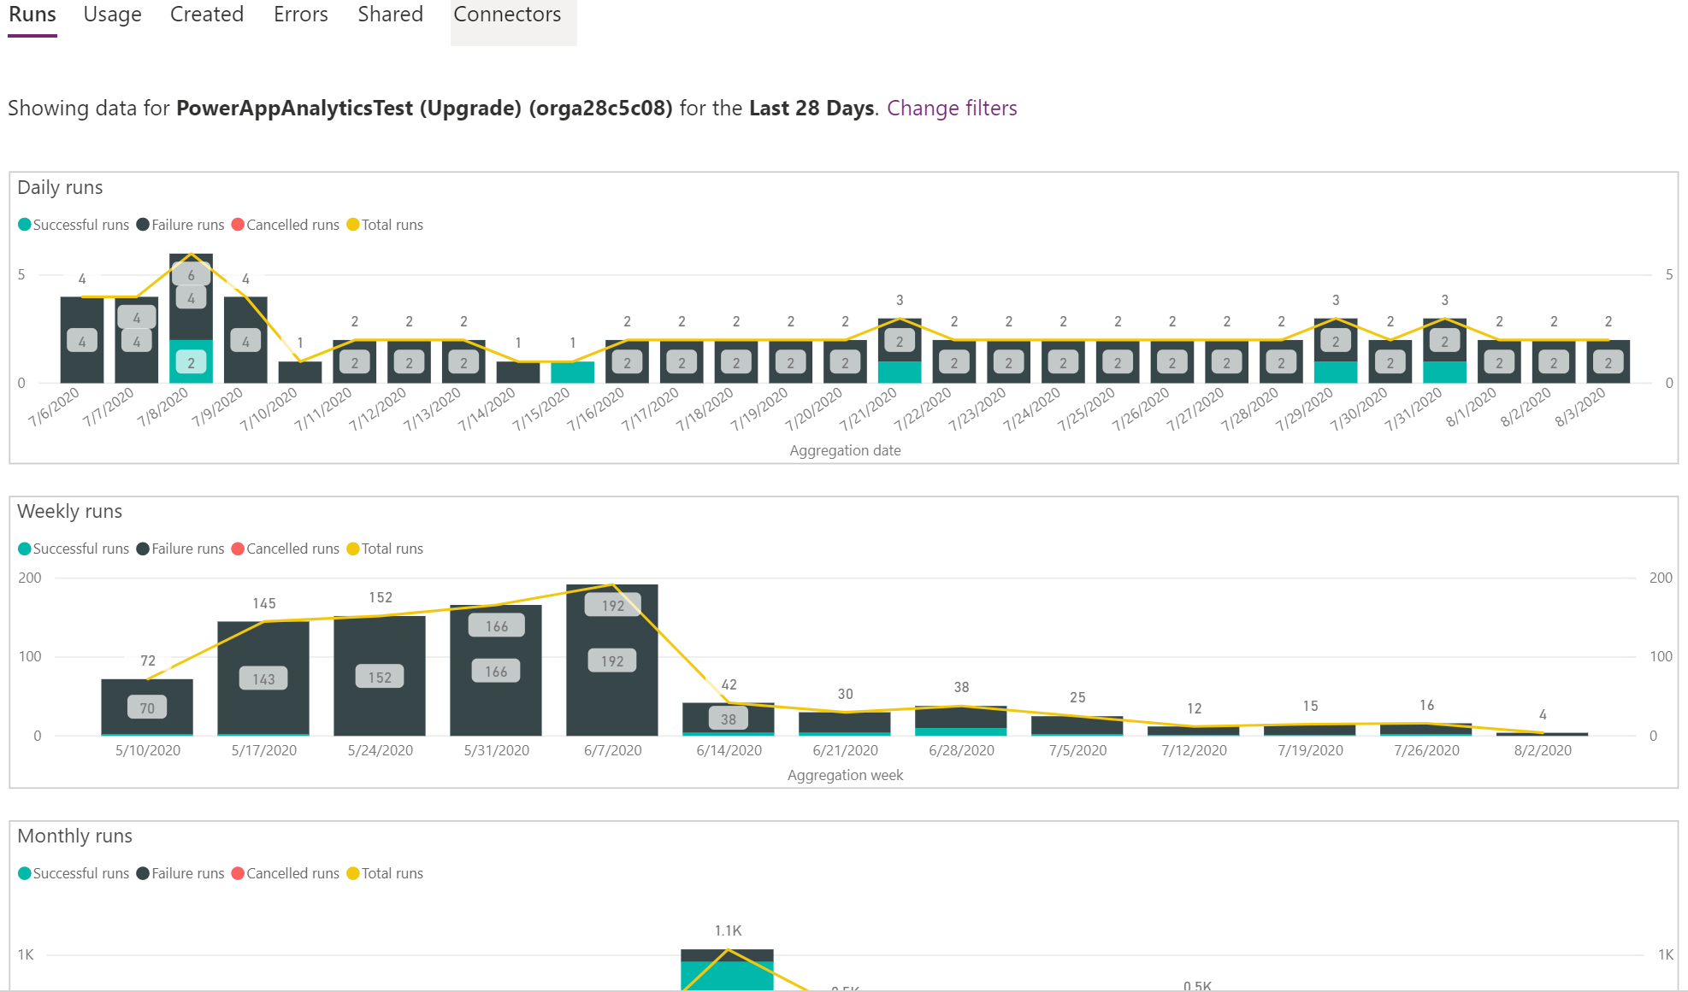
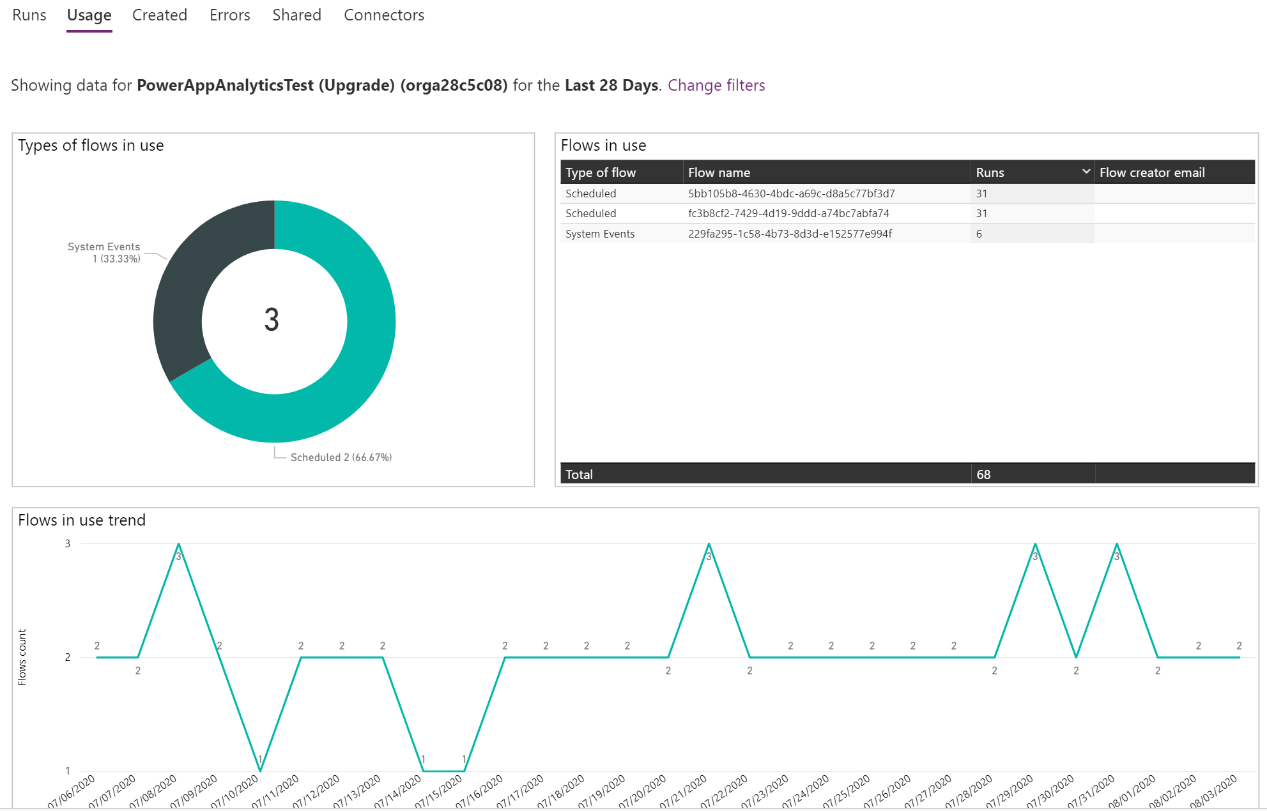
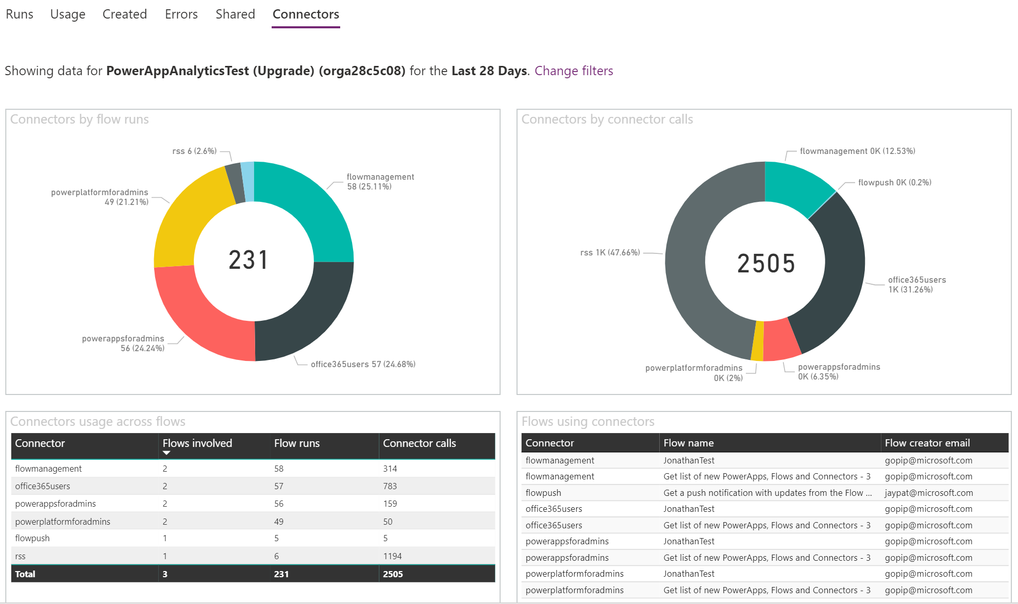
Power Automate – Environment level views
Analytics is available for a 7, 14, 28-day time periods and allows users to switch between environments.
Notes:
Microsoft Dataverse is focused on database and model-driven app user activity
PowerApps is targeted toward canvas app
The data is stored only in the region that an environment is hosted in.

Slide 11
Power Apps admin analytics provides environment level views
Administrators can view data at the environment level for canvas apps
Active Users – How many users are using the app and daily active usage
Location – Where is the app usage and filter by country
App Usage – App launches with filters for device platform, player version, country
Toast errors are errors which end users see
Errors per app in the environment,
Error trends across apps,
Overview across all apps for error breakdown by https status
Service Performance – Best and lest performing service(std and custom) in the environment
As an administrator:
Monitor how much and where apps are being used
Check out the platform being used to launch the apps, browser or mobile, Tailor your app updates based on platform and ensure that users are on the latest player version to ensure latest platform updates
Identify apps with most errors and common http errors and work with makers to understand and fix issues ensure overall security of platform
Get an overview of overall performance of different custom and standard API”s being used in the apps. Work with teams to fix issues proactively
Notes:
Microsoft Dataverse is focused on database and model-driven app user activity
PowerApps is targeted toward canvas app
The data is stored only in the region that an environment is hosted in.

Slide 12
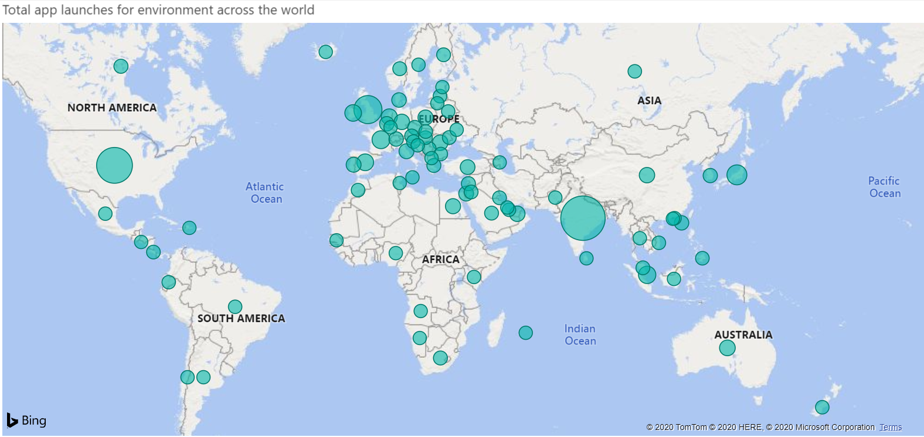
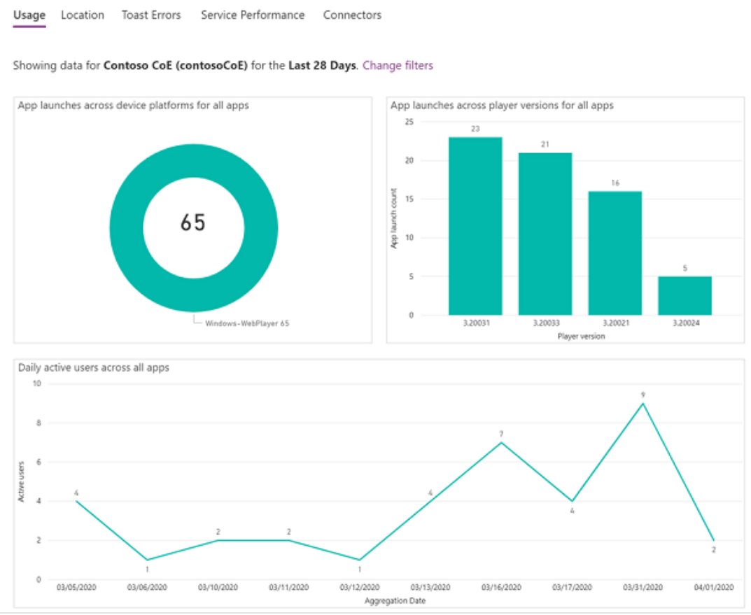
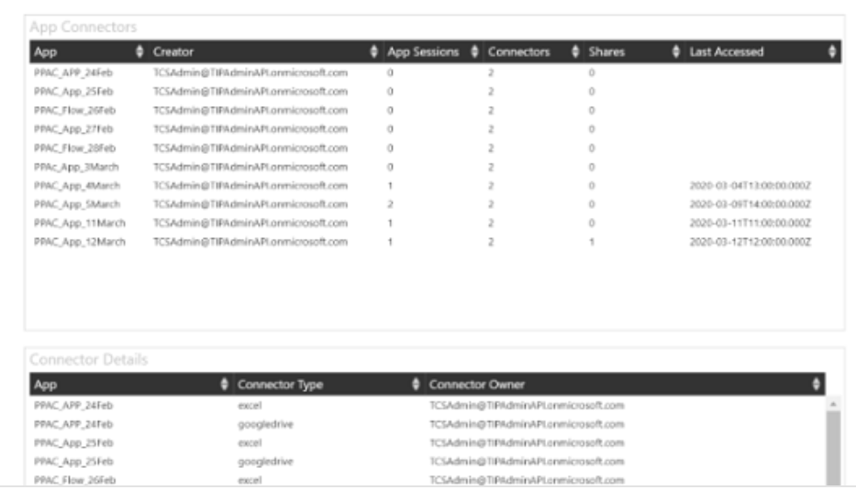
Power Apps – Admin analytics environment level views
Analytics is available for canvas apps for a 7, 14 and 28-day time periods and allows users to switch between environments.
Notes:
Microsoft Dataverse is focused on database and model-driven app user activity
PowerApps is targeted toward canvas app
The data is stored only in the region that an environment is hosted in.

Slide 13
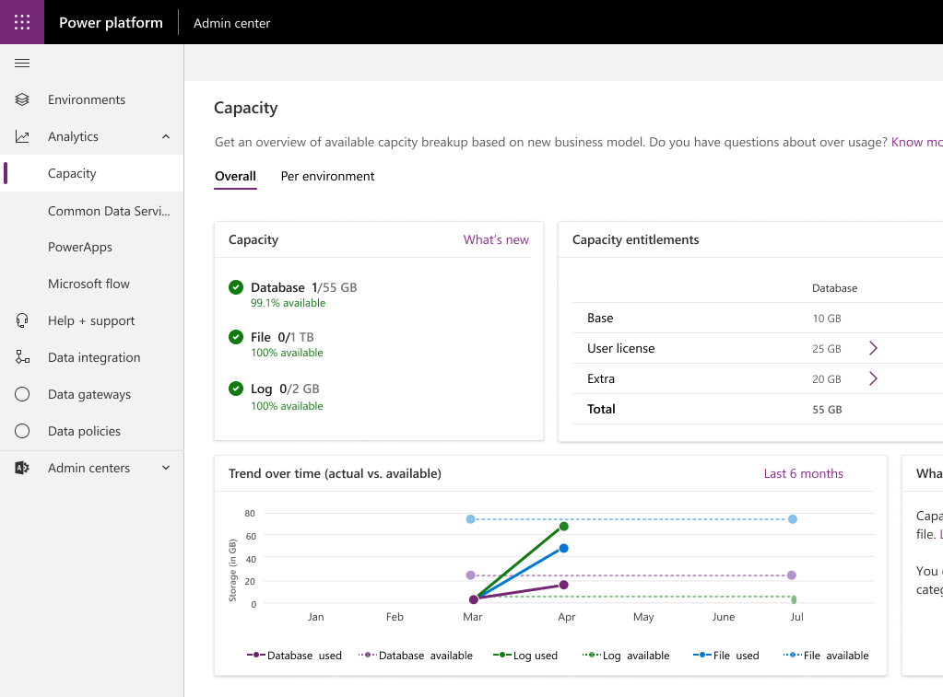
Monitoring Capacity & Why is it important?
Monitoring storage capacity report Storage capacity entitlements and usage for database, file and log capacity
Create additional environments
When 1GB of database capacity available
No separate license for prod/non-prod envs
Coming summer 2019
Increased storage File/Log capacity frees up database capacity 4TB size limit does not apply to File/Log capacity
Report sample—for illustration only
Notes:
Create additional instances
New instances can be created if 1 GB of database capacity is available at a minimum as the new environment will consume 1 GB.
New storage capacity report
New storage capacity report will be available in the Power Platform Admin center. It will outline entitlements and usage for database, file and log capacity.
Increased storage
Organizations will get additional storage allocations (default/user) for file and log capacity. As File and audit logs are removed from the database capacity, storage frees up. The db size limitations do not apply to file/log capacity.
Transition to new platform capacity
Customers do not need to take action. Existing APIs are backwards compatible.

Slide 14
Gain Deeper Insight on Storage Capacity
Capacity management & enforcement
Understand storage and consumption
Access for environment admins, power platform service admins, D365 and global admins and individual users who have purchased a license
https://aka.ms/ppac
Notes:
The Power Platform offers admins greater insight into how storage capacity is being used.

Slide 15
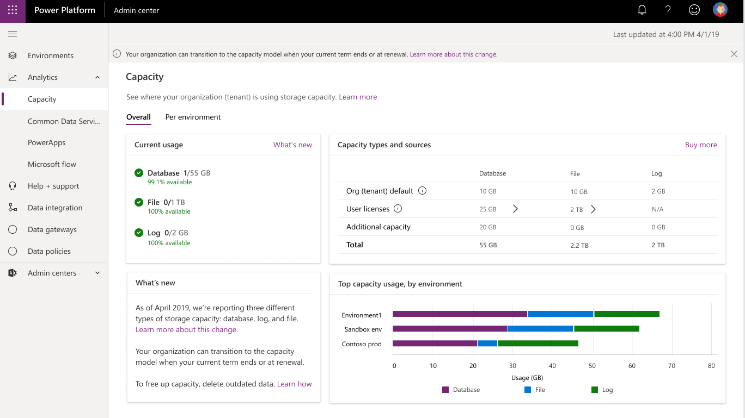
Capacity report for customers on new storage based licensing model

Slide 16
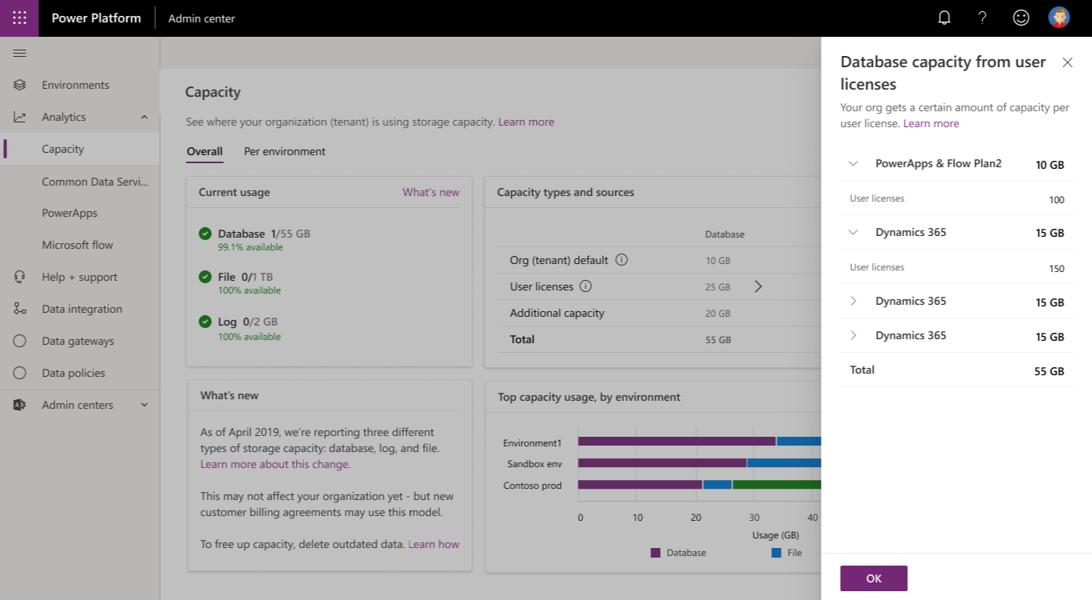
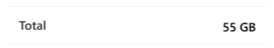
Storage capacity entitlements breakdown
25 GB
Notes:
We provide visibility into entitlements.

Slide 17
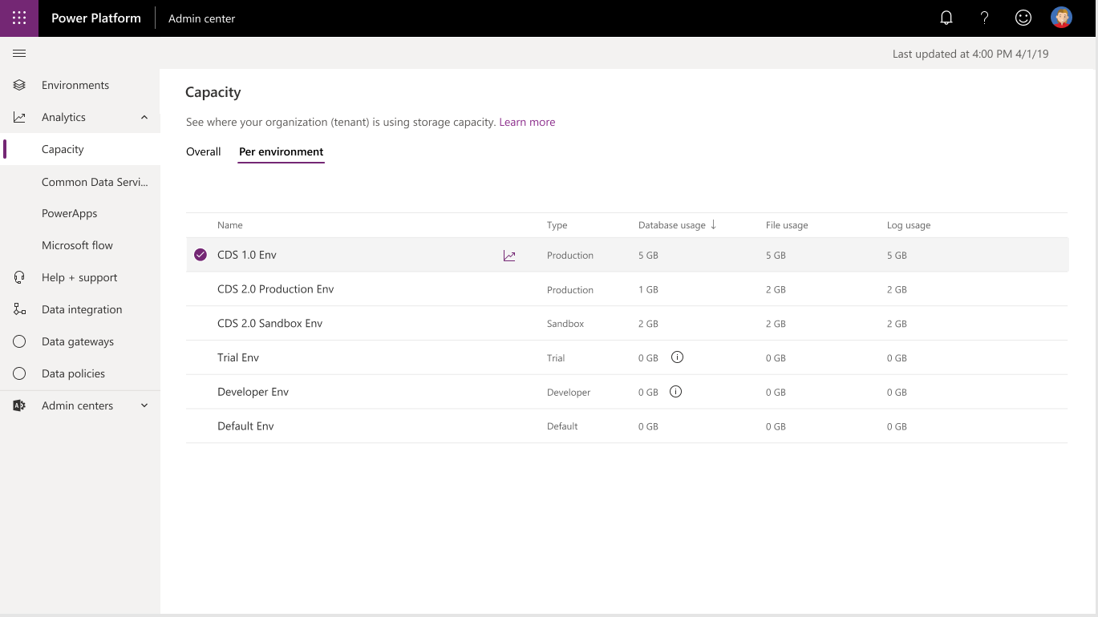
Per environment breakdown
Notes:
We also provide detailed capacity metrics for each individual environment that a customer is using.

Slide 18
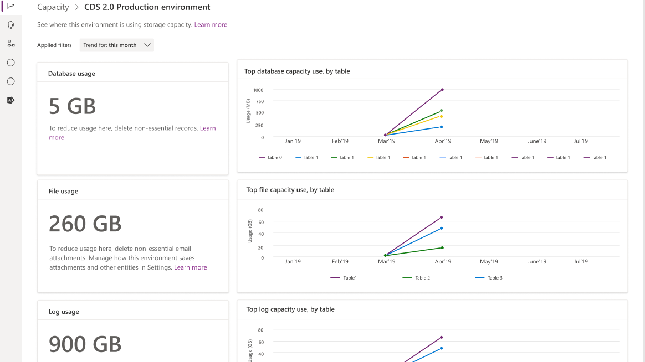
Database, File and Log Capacity usage per Dataverse environment
Notes:
Finally, there is a detailed view on file capacity and logs. All of this information is rich in detail and easily accessible.

Slide 19
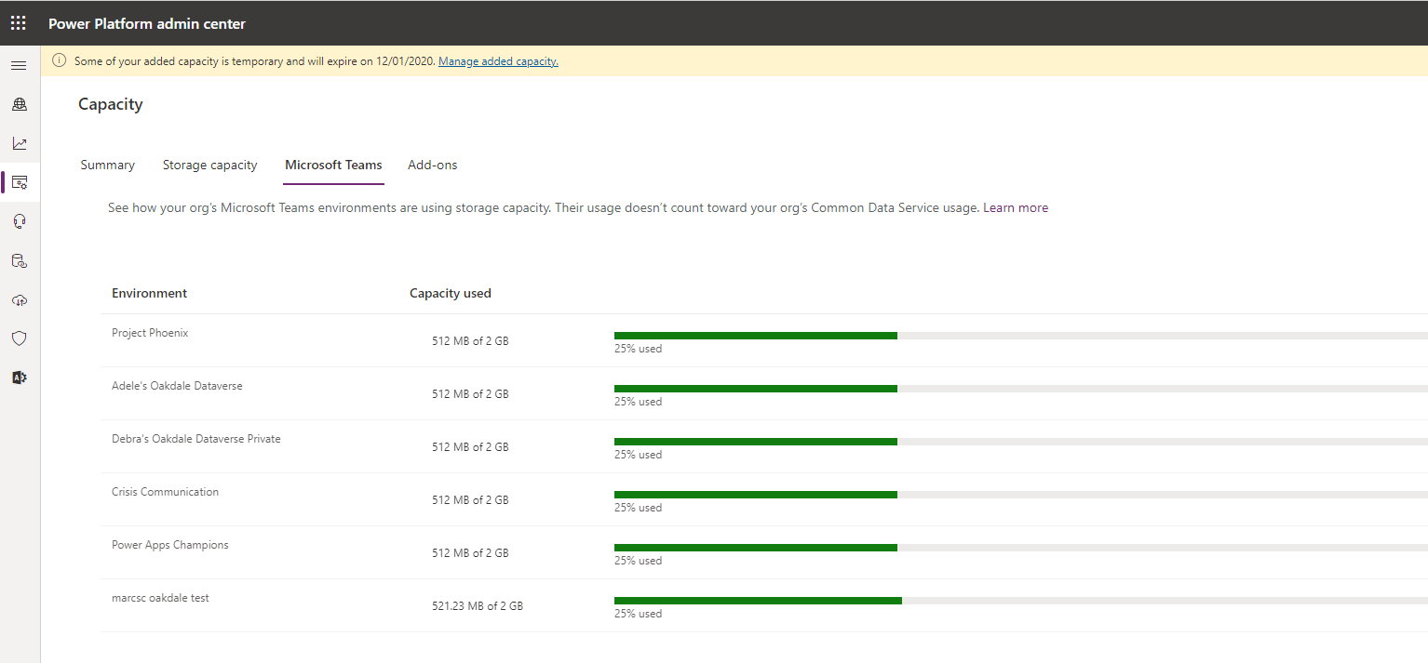
Dataverse for Teams capacity
Notes:
Finally, there is a detailed view on file capacity and logs. All of this information is rich in detail and easily accessible.

Slide 20
Capacity enforcements
Following storage capacity enforcements apply today
Tenant overall capacity need to be with-in the entitled limits. The PPAC experience will call out if that is not the case
Creating a new environment, copy and restore are the three operations that are enforced today in an event of capacity overuse
Also min 1GB of available DB capacity is required for creating a new environment
Notes:
Also, to ensure compliance, we apply some capacity enforcements.

Slide 21
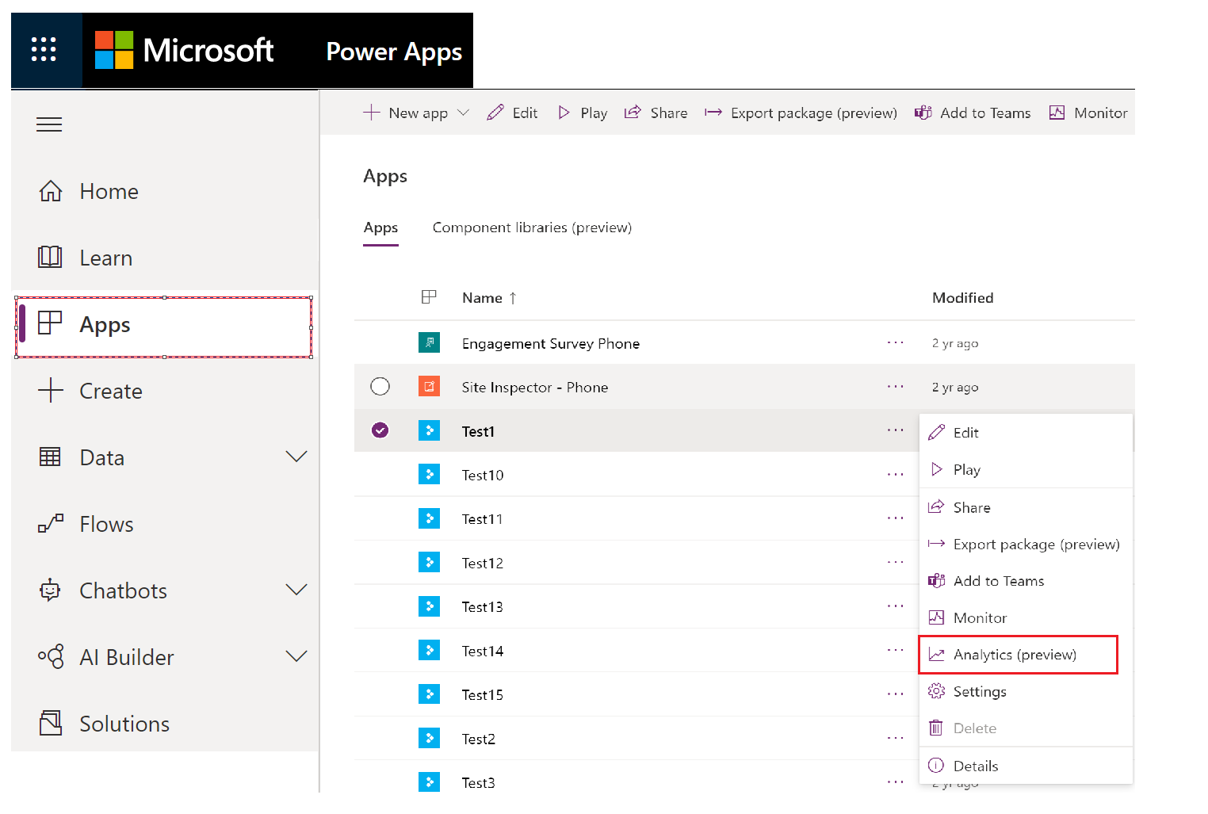
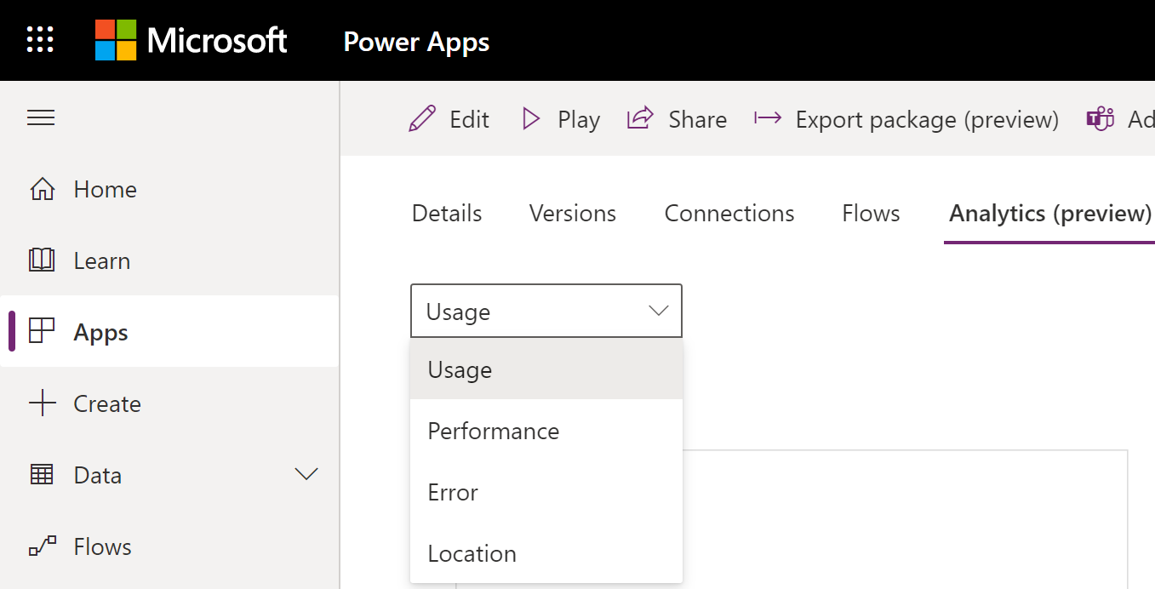

Maker analytics for Power Apps – Individual app level views
App Makers and Administrators can view details for each app within their scope, for last 7, 14, 28 days with data refreshed every 4-6 hours
https://make.powerapps.com
App Adoption and Usage
App Health
Active Users – How many users are using the app and daily active usage
Location – Where is the app usage and filter by country
App Usage – App launches with filters for device platform, player version, country
Toast errors are errors which end users see
Errors per app in the environment,
Error trends across apps,
Overview across all apps for error breakdown by https status
Performance – Best and lest performing service(std and custom) in the environment
Notes:
Dataverse is focused on database and model-driven app user activity
PowerApps is targeted toward canvas app
The data is stored only in the region that an environment is hosted in.

Slide 22
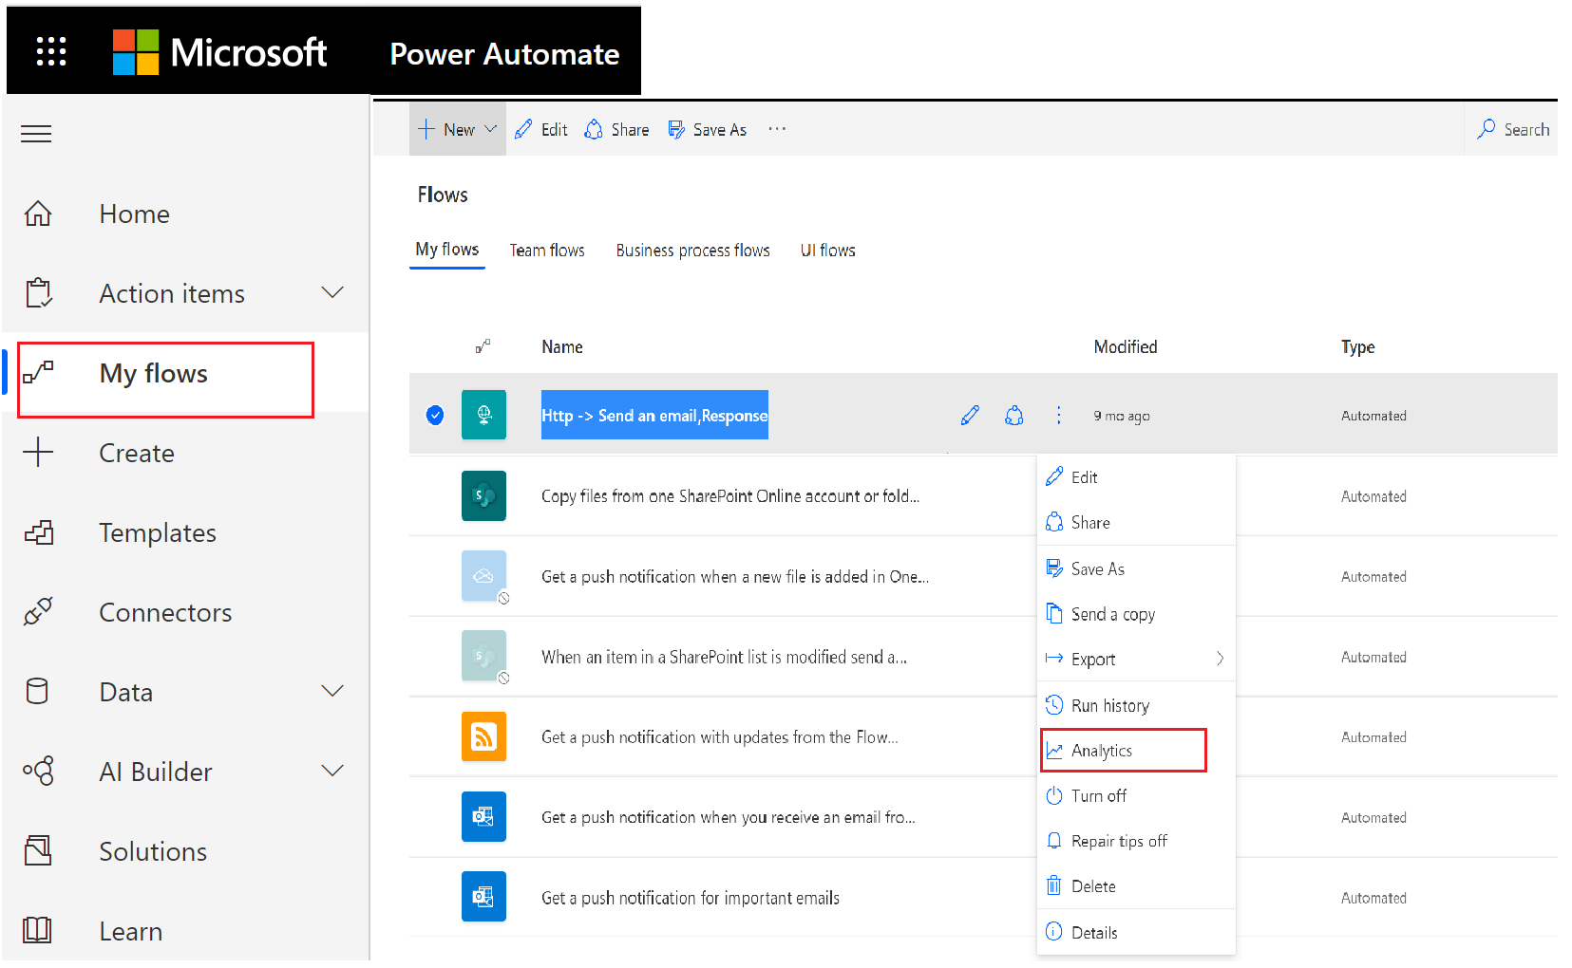
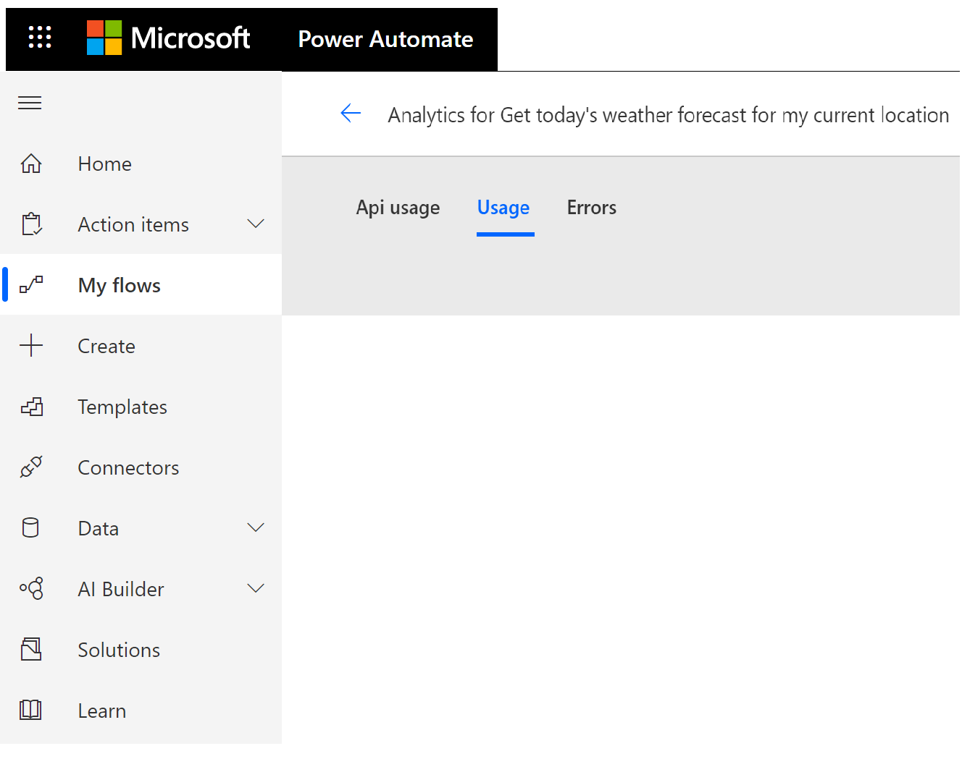
Maker analytics for Power Automate – Individual flow level views
Flow Makers and Administrators can view details for each flow within their scope, for last 7, 14, 28 days with data refreshed every 4-6 hours
https://flow.microsoft.com
Flow Usage
Flow Health
API usage
Runs by day
Total number of runs for the flow
Gain insights into when the flow is run with the flow run trends
The number of errors per day
Flow errors by type
Understand the details of a specific error – Error source, action or trigger name, error status code, error count, last error occurrence, last error message and detail
Notes:
Dataverse is focused on database and model-driven app user activity
PowerApps is targeted toward canvas app
The data is stored only in the region that an environment is hosted in.

Slide 23


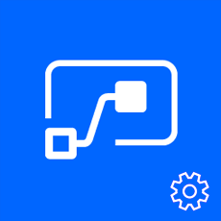

Leverage automation tooling for audit process and reporting
Pull the metadata you need to build the custom reports you want
Build the policies you need to implement administration + governance requirements. Use the management connectors to permit or restrict behavior based on your organization’s policie
PowerShell Cmdlets - aka.ms/powerappspowershell
Management connectors – Power Platform APIs in an accessible connector interface, provide admin access to resources
REST API – Leverage APIs directly from any programming language
Power Platform for Admins
Power Apps for Admins
Power Automate - Flow Management
Power Apps for App Makers

Slide 24
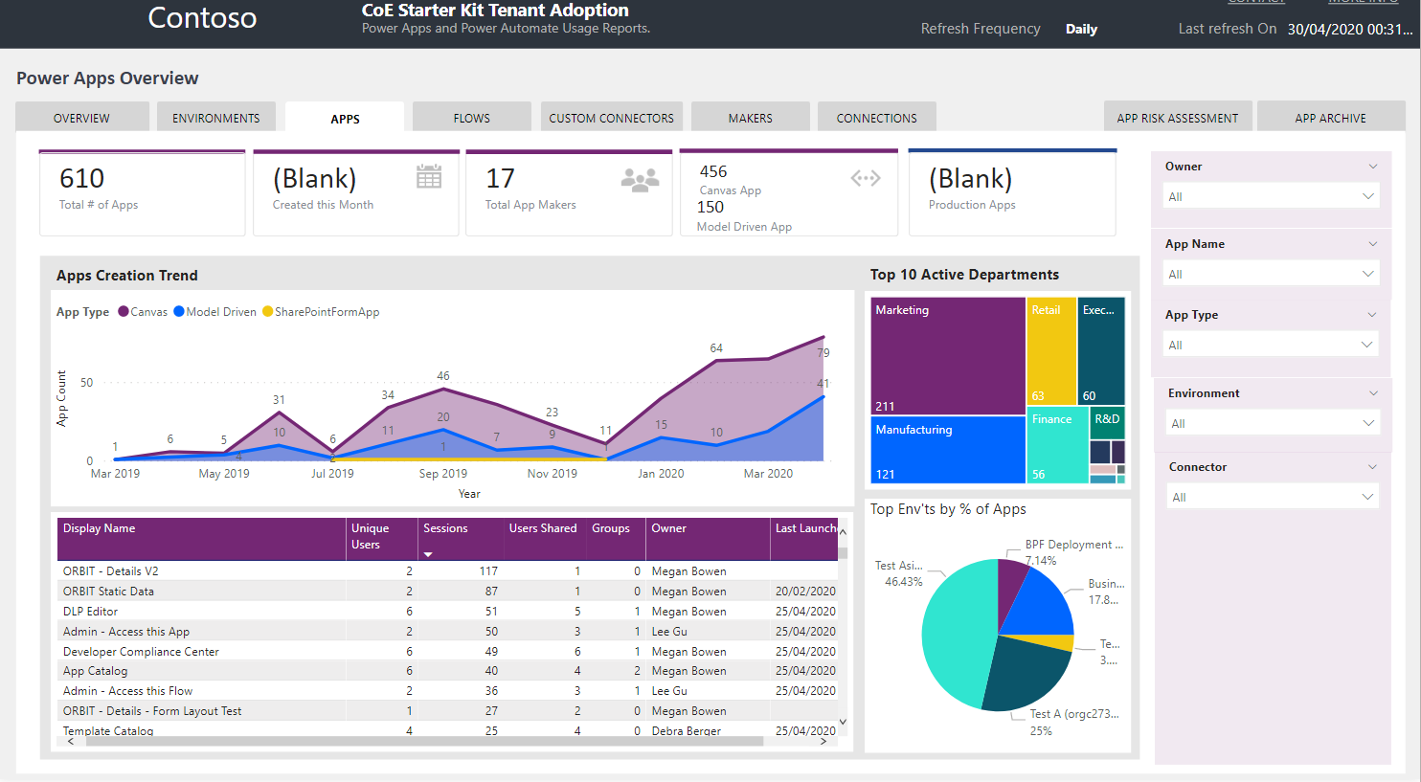
Cross Tenant Dashboard
Build using the CoE Starter Kit backed by telemetry from the O365 Activity Logging capabilities
Notes:
You can take the information from the management connectors and the Audit Logs and build your own dashboards to create a cross tenant dashboard, that uses the audit log together with information you have in your tenant to get an overview of all your apps, all your flows, all your makers and identify trends over time. The example here comes with the CoE Starter Kit, which will look into later.
If you haven’t already looked at the starter kit, we really recommend you exploring it. Lots of partners and customers are getting a lot of value from it.

Slide 25
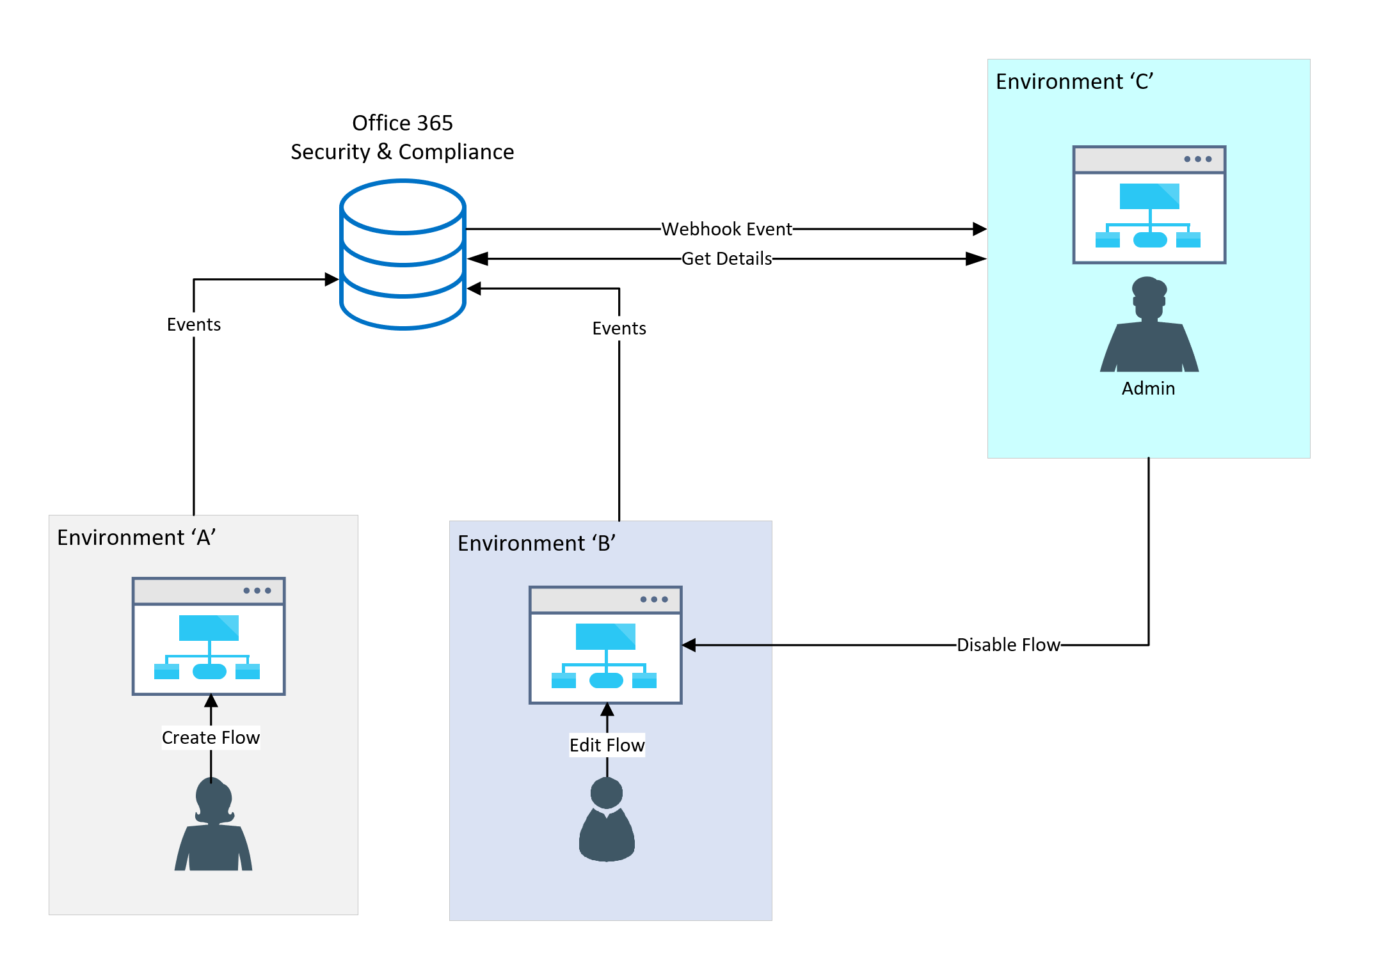
Configure audit logs
Audit log data allows looking at activity that occurred in the platform
Office 365 Activity Logging
Dataverse Data Activity Logging
Notes:
There are two types of audit logging that can be used to monitor activity in the platform. Office 365 activity logging can be enabled to monitor activity such as creating resources and using resources like flows or canvas apps. This can be used with out Dataverse being in an environment. Dataverse audit can be configured to monitor user usage and modification of Dataverse entities.

Slide 26
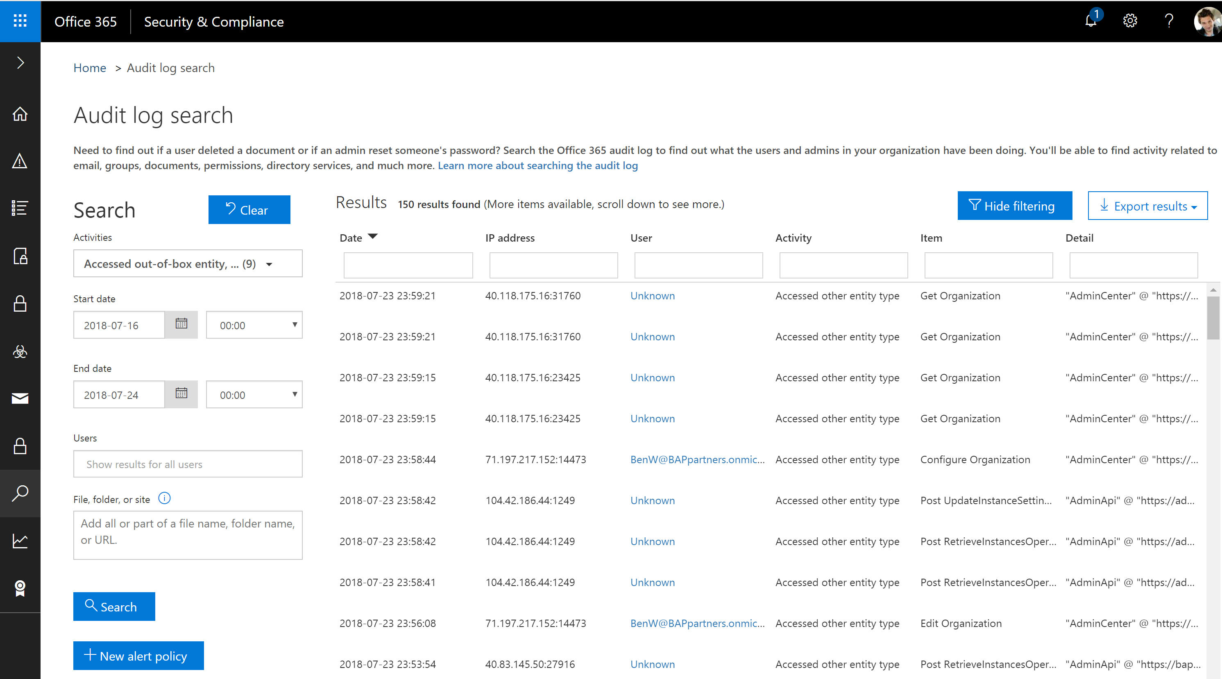
Office 365 Activity Logging
Alert
Activity Logging integrated with Office Security and Compliance center for comprehensive logging across Microsoft services
The audit records are stored in Office 365 Security and Compliance center
Office provides an API to query this data, which is currently used by many SIEM vendors to use the Activity Logging data for reporting

Slide 27
Which activity logs are supported?
Power Automate | Power Apps
Created flow Edited flow Deleted flow Edited permissions Deleted permissions Started a paid trial Renewed a paid trial | Created app Edited/save app (draft) Published app Deleted app Restored an app from app version Launched app Marking app as featured Marking app as hero Edited app permissions Deleted app permissions

Slide 28
Enable Office 365 activity logging
Must have an Office 365 E3 or greater license
Must enable at the organization level
Enable-OrganizationCustomization
Set-AdminAuditLogConfig -UnifiedAuditLogIngestionEnabled $true
Non service admins need permissions to view
E.g. Add-RoleGroupMember "Compliance Management" -Member user1
Notes:
https://docs.microsoft.com/en-us/office365/securitycompliance/turn-audit-log-search-on-or-off

Slide 29

Build flows to alert on key audit events
An example of alerting that can be implemented is subscribing to Office 365 Security and Compliance Audit Logs
This can be achieved through either a webhook subscription or polling approach. However, by attaching Flow to these alerts, we can provide administrators with more than just email alerts
Activity Logging Web Svc
Power Apps logs
Power Automate logs
Admin
Power Automate

Slide 30
Dataverse Auditing
Three level configuration
All custom and most customizable entities can be audited
1. Environment
2. Entity
3. Field
Notes:
You enable or disable auditing at the environment level by setting in the admin portal on the environment. However, for entities and attributes, you set a property value of the entity or attribute metadata.

Slide 31
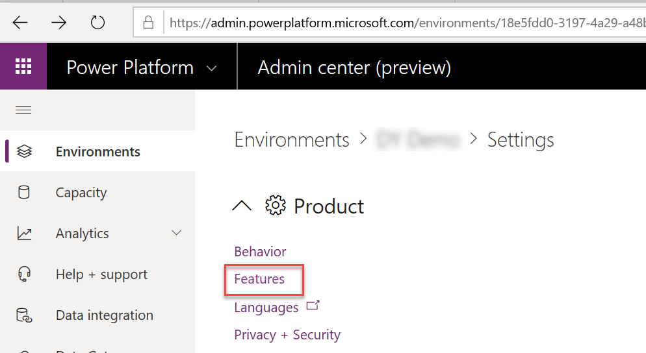
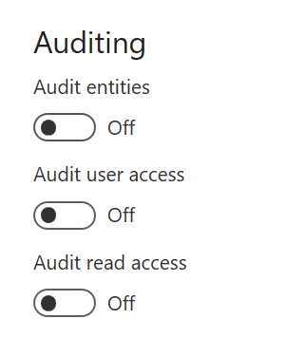
Enable Dataverse auditing for the environment
Notes:
Audit entities enables tracking of modifications to entity data to be tracked, this data is viewed in the context of the record in Dataverse
Audit user access and read access logs the data and it shows up in the Office 365 Security and Compliance center with other activity.

Slide 32
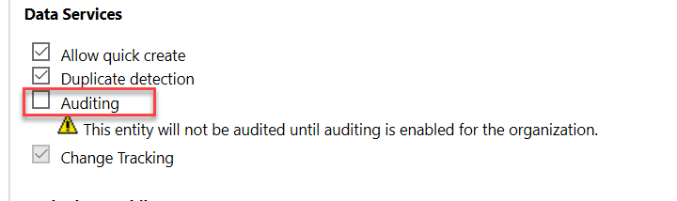
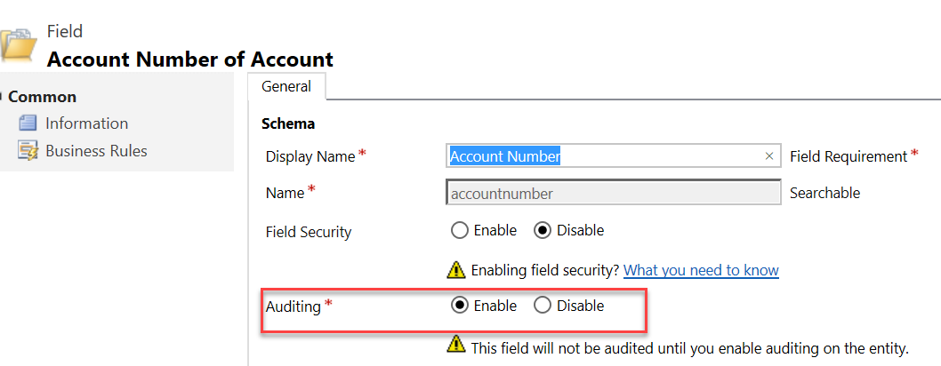
Enable for Entity and Field
Entity Level
Field Level
Notes:
This must be done on classic solution explorer

Slide 33
What about planned & unplanned platform changes/incidents?

Slide 34
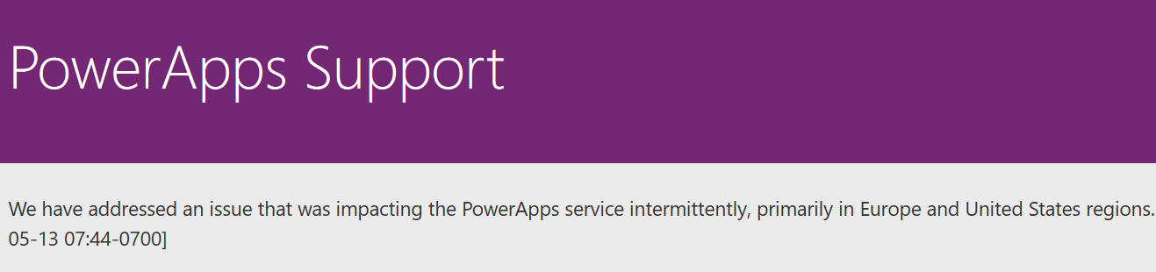
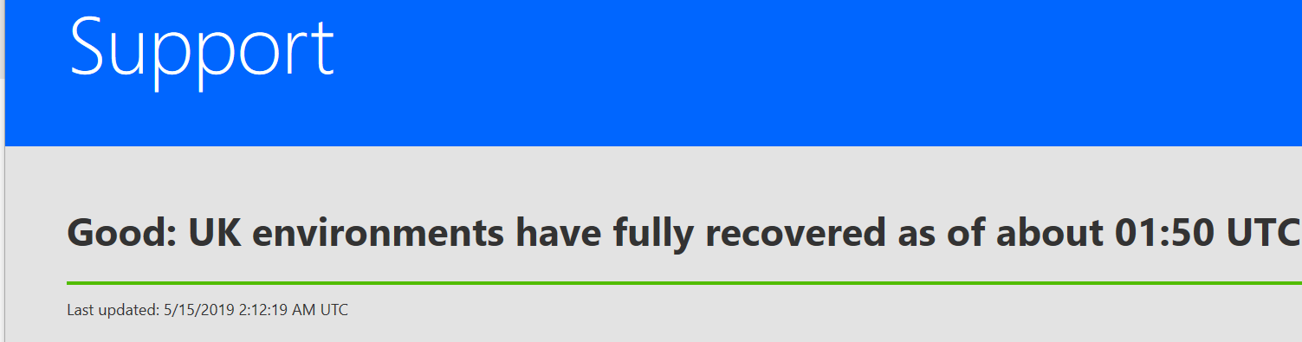
Monitoring platform status and updates
Power Apps Support
powerapps.microsoft.com/en-us/support/
Power Automate Support
flow.microsoft.com/en-us/support/
Service Health Dashboard and Message Center
Work done to maintain, and update Dynamics 365 services are communicated here, non-dynamics Power Apps and Power Automate messages will be here in the future

Slide 35
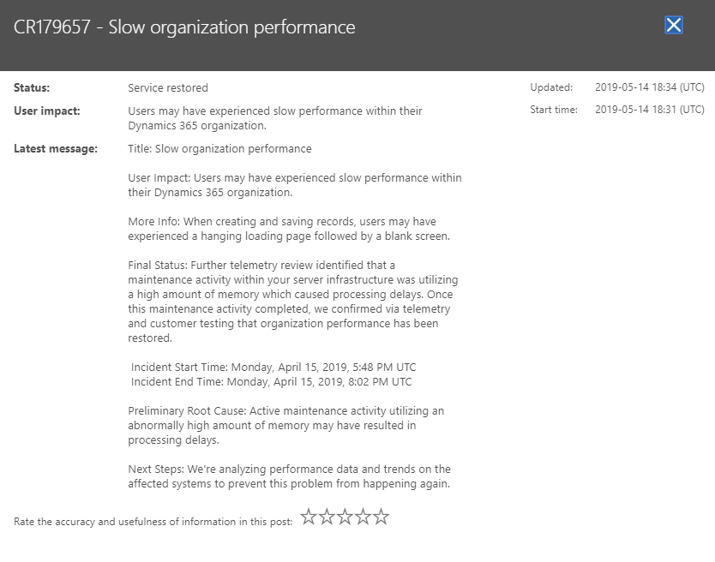
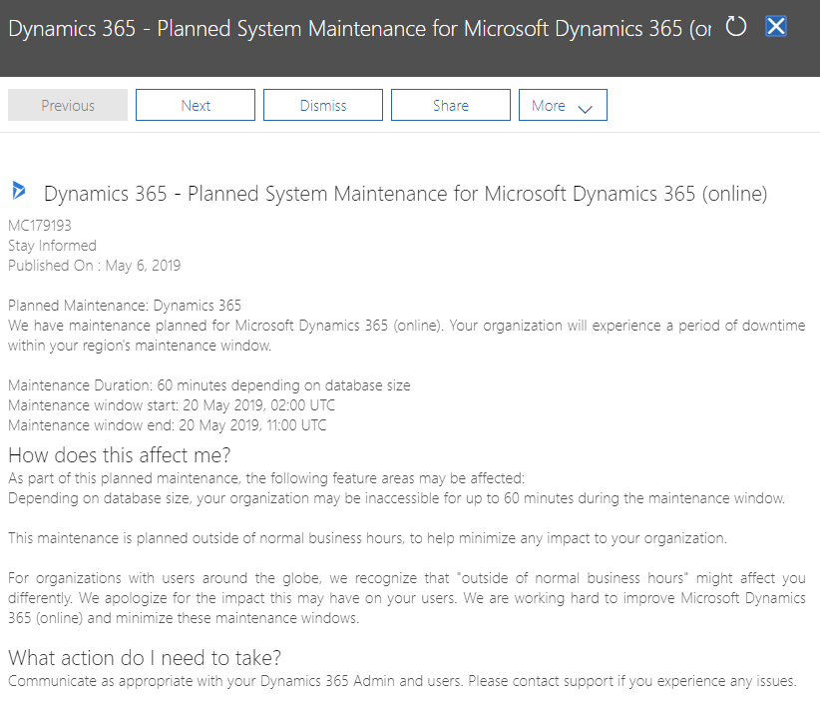
Service Health Dashboard & Message Center
Microsoft regularly communicates work done to maintain and update Dynamics 365 services to ensure security, performance, and availability, and to provide new features and functionality.
Microsoft also communicates details of service incidents including the potential user experience, the start and end time of the incident, and any workaround that may be available..
The Service health dashboard is used to communicate service incident information throughout the duration of the event. This would include the following issue statuses:
Investigating – Microsoft is investigating an event to determine the customer impact.
Service Degradation/Service Interruption- Microsoft has confirmed services are being impacted and is taking immediate action to understand the failure and steps required to restore service.
Restoring Service - Cause of the incident has been identified and mitigation steps are in progress.
Extended Recovery - Services are restored but may be slower than usual.
False Positive - Microsoft has confirmed that there was no customer impact
The Message center is used for Proactive communications to inform our customers of any of the following scenarios:
Deployments (Releases)
Maintenance
Customer Action Needed
Monthly Updates
Service Changes
Deprecation of Functionality
Service Health Dashboard – Service Restored
Message Center – Maintenance
Notes:
For each of these activities, communication is provided through the Microsoft 365 Admin center through the Message Center, and the Service health dashboard

Slide 36
Module Review
Analytics are helpful to monitor on-going activity and perform capacity planning
Activity auditing allows monitoring of what has happened in an environment
Working with makers ensures you are collecting necessary audit data
Notes:
Start Time xx:xx / Length: 2 minutes
Review the objectives for this module.
Ask participants to use the Text tool to write on the screen if they had any questions about the module.

